Slide 1

Bias-variance Trade-off
Dr. Pei Xu
Auburn University
Monday, February 05, 2018

Slide 2
Measuring Quality of Fit
One common measure of accuracy for a regression problem is the mean squared error (MSE) i.e.
Where is the prediction our method gives for the observation in our training data.

Slide 3
Training vs. Test MSE’s
We want to choose the method that gives the lowest test MSE, as opposed to the lowest training MSE
We are interested in the accuracy of the predictions that we obtain when we apply our method to test dataset.
Examples:
Predict a stock’s price
Predict risk of diabetes

Slide 4
Training vs. Test MSE’s
In general the more flexible a method is the lower its training MSE will be i.e. it will “fit” or explain the training data very well.
Side Note: More Flexible methods (such as splines) can generate a wider range of possible shapes to estimate f as compared to less flexible and more restrictive methods (such as linear regression). The less flexible the method, the easier to interpret the model. Thus, there is a trade-off between flexibility and model interpretability.
However, the test MSE may in fact be higher for a more flexible method than for a simple approach like linear regression.

Slide 5
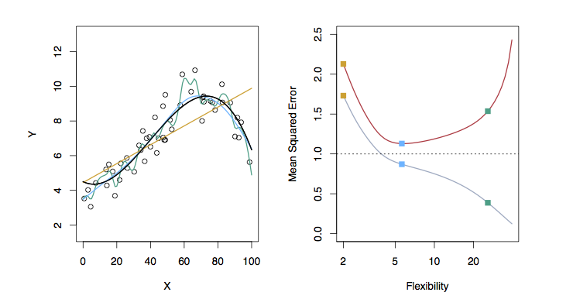
Examples with Different Levels of Flexibility: Example 1
LEFT
Black: Truth
Orange: Linear Estimate
Blue: smoothing spline
Green: smoothing spline (more flexible)
RIGHT
RED: Test MES
Grey: Training MSE
Dashed: Minimum possible test MSE (irreducible error)
Notes:
Overfitting: when a given method yields a small training MSE but a large test MSE, we are said to be overfitting the data.
Training MSE decreases monotonically as the model flexibility increases, and that there is a U-shape in the test MSE.

Slide 6
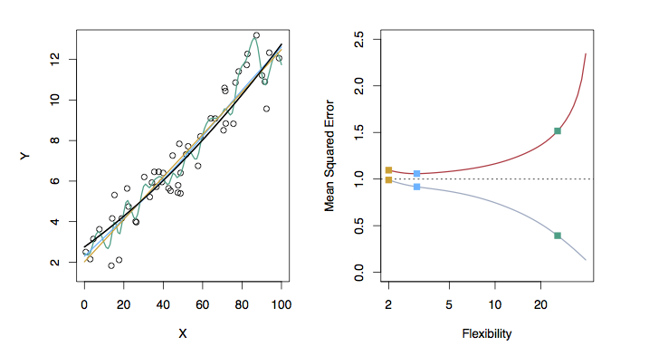
Examples with Different Levels of Flexibility: Example 2
LEFT
Black: Truth
Orange: Linear Estimate
Blue: smoothing spline
Green: smoothing spline (more flexible)
RIGHT
RED: Test MES
Grey: Training MSE
Dashed: Minimum possible test MSE (irreducible error)

Slide 7
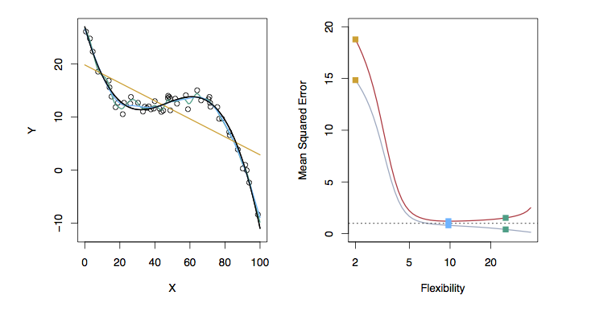
Examples with Different Levels of Flexibility: Example 3
LEFT
Black: Truth
Orange: Linear Estimate
Blue: smoothing spline
Green: smoothing spline (more flexible)
RIGHT
RED: Test MES
Grey: Training MSE
Dashed: Minimum possible test MSE (irreducible error)

Slide 8
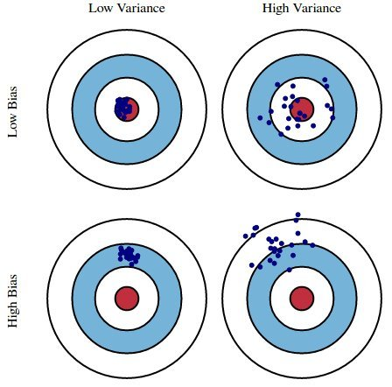
Bias/ Variance Tradeoff
The U-shape observed in the test MSE curves illustrates a very important tradeoff that governs the choice of statistical learning methods.
There are always two competing forces that govern the choice of learning method i.e. bias and variance.
Fig. 1: Graphical illustration of bias and variance
Notes:
We also call them validity and reliability.

Slide 9
The Trade-off
It can be shown that for any given, X=x₀, the expected test MSE for a new Y at x₀ will be equal to
What this means is that as a method gets more complex the bias will decrease and the variance will increase but expected test MSE may go up or down!

Slide 10
Bias of Learning Methods
Bias refers to the error that is introduced by modeling a real life problem (that is usually extremely complicated) by a much simpler problem.
For example, linear regression assumes that there is a linear relationship between Y and X. It is unlikely that, in real life, the relationship is exactly linear so some bias will be present.
The more flexible/complex a method is the less bias it will generally have.

Slide 11
Variance of Learning Methods
Variance refers to how much your estimate for f would change by if you had a different training data set.
Generally, the more flexible a method is the more variance it has.

Slide 12
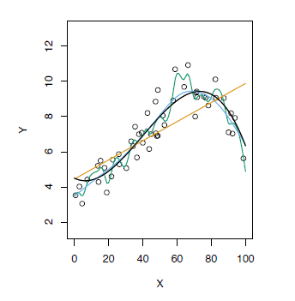
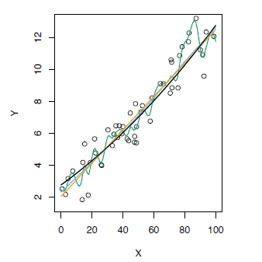
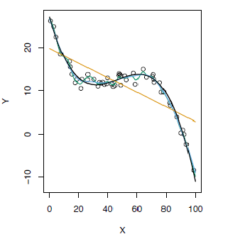
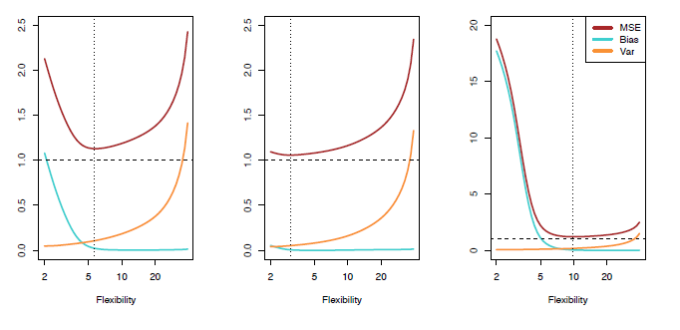
Test MSE, Bias and Variance

Slide 13
Reference
James, Witten, Hastie, and Tibshirani. “An Introduction to Statistical Learning with Applications in R. (Springer; 1st ed. 2013)” ISBN-13: 978-1461471370; ISBN-10: 1461471370 (Chapter 2)

